Slide 1
Software Project Management and Software Metrics
Session 27-28
Course : COMP6100/Software Engineering
Effective Period : Desember 2017

Slide 2
These slides have been adapted from
Pressman, R.S. (2015). Software Engineering : A Practioner's Approach. 8th ed. McGraw-Hill Companies.Inc, Americas, New York. ISBN : 978 1 259 253157. Chapter 30, 31 and 32
Acknowledgement

Slide 3
LO 4 : Analyze the software project management and the proposed potential business project
Learning Objectives

Slide 4
Contents
Team Coordination & Communication
Problem Decomposition
A Framework for Product Metrics
Metrics for the Requirements Model
Metrics for the Design Model
Design Metrics for WebApps
Code Metrics
Metrics for Testing
Maintenance Metrics
Metrics in the Process and Project Domain
Software Measurement
Metrics for Software Quality

Slide 5
Team Coordination and
Communication
Formal, impersonal approaches include software engineering documents and work products (including source code), technical memos, project milestones, schedules, and project control tools, change requests and related documentation, error tracking reports, and repository data.
Formal, interpersonal procedures focus on quality assurance activities applied to software engineering work products. These include status review meetings and design and code inspections.
Informal, interpersonal procedures include group meetings for information dissemination and problem solving and “collocation of requirements and development staff.”
Electronic communication encompasses electronic mail, electronic bulletin boards, and by extension, video-based conferencing systems.
Interpersonal networking includes informal discussions with team members and those outside the project who may have experience or insight that can assist team members.

Slide 6
Problem Decomposition
Sometimes called partitioning or problem elaboration
Once scope is defined …
  It is decomposed into constituent functions
  It is decomposed into user-visible data objects
  or
  It is decomposed into a set of problem classes
Decomposition process continues until all functions or problem classes have been defined

Slide 7
The Process
Problem Decomposition
Once a process framework has been established
  Consider project characteristics
  Determine the degree of rigor required
  Define a task set for each software engineering activity
    Task set =
      Software engineering tasks
      Work products
      Quality assurance points
      Milestones

Slide 8
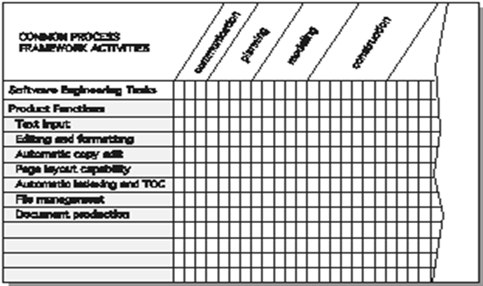
Melding the Problem and the Process
Problem Decomposition

Slide 9
McCall’s Triangle of Quality
A Framework for
Product Metrics
M
a
i
n
t
a
i
n
a
b
i
l
i
t
y
M
a
i
n
t
a
i
n
a
b
i
l
i
t
y
P
o
r
t
a
b
i
l
i
t
y
P
o
r
t
a
b
i
l
i
t
y
F
l
e
x
i
b
i
l
i
t
y
F
l
e
x
i
b
i
l
i
t
y
R
e
u
s
a
b
i
l
i
t
y
R
e
u
s
a
b
i
l
i
t
y
T
e
s
t
a
b
i
l
i
t
y
T
e
s
t
a
b
i
l
i
t
y
I
n
t
e
r
o
p
e
r
a
b
i
l
i
t
y
I
n
t
e
r
o
p
e
r
a
b
i
l
i
t
y
P
R
O
D
U
C
T
R
E
V
I
S
I
O
N
P
R
O
D
U
C
T
T
R
A
N
S
I
T
I
O
N
P
R
O
D
U
C
T
R
E
V
I
S
I
O
N
P
R
O
D
U
C
T
T
R
A
N
S
I
T
I
O
N
P
R
O
D
U
C
T
O
P
E
R
A
T
I
O
N
P
R
O
D
U
C
T
O
P
E
R
A
T
I
O
N
C
o
r
r
e
c
t
n
e
s
s
C
o
r
r
e
c
t
n
e
s
s
U
s
a
b
i
l
i
t
y
U
s
a
b
i
l
i
t
y
E
f
f
i
c
i
e
n
c
y
E
f
f
i
c
i
e
n
c
y
R
e
l
i
a
b
i
l
i
t
y
I
n
t
e
g
r
i
t
y
R
e
l
i
a
b
i
l
i
t
y
I
n
t
e
g
r
i
t
y

Slide 10
Goal-Oriented Software Measurement
A Framework for
Product Metrics
A measure provides a quantitative indication of the extent, amount, dimension, capacity, or size of some attribute of a product or process
The IEEE glossary defines a metric as “a quantitative measure of the degree to which a system, component, or process possesses a given attribute.”
An indicator is a metric or combination of metrics that provide insight into the software process, a software project, or the product itself

Slide 11
Metrics Attributes
A Framework for
Product Metrics
Simple and computable. It should be relatively easy to learn how to derive the metric, and its computation should not demand inordinate effort or time
Empirically and intuitively persuasive. The metric should satisfy the engineer’s intuitive notions about the product attribute under consideration
Consistent and objective. The metric should always yield results that are unambiguous.
Consistent in its use of units and dimensions. The mathematical computation of the metric should use measures that do not lead to bizarre combinations of unit.
Programming language independent. Metrics should be based on the analysis model, the design model, or the structure of the program itself.
Effective mechanism for quality feedback. That is, the metric should provide a software engineer with information that can lead to a higher quality end product

Slide 12
Metrics for the Requirements Model
Function-based metrics: use the function point as a normalizing factor or as a measure of the “size” of the specification
Specification metrics: used as an indication of quality by measuring number of requirements by type

Slide 13
Function-Based Metrics
Metrics for the Requirements Model
The function point metric (FP), first proposed by Albrecht [ALB79], can be used effectively as a means for measuring the functionality delivered by a system.
Function points are derived using an empirical relationship based on countable (direct) measures of software's information domain and assessments of software complexity
Information domain values are defined in the following manner:
  number of external inputs (EIs)
  number of external outputs (EOs)
  number of external inquiries (EQs)
  number of internal logical files (ILFs)
  Number of external interface files (EIFs)

Slide 14
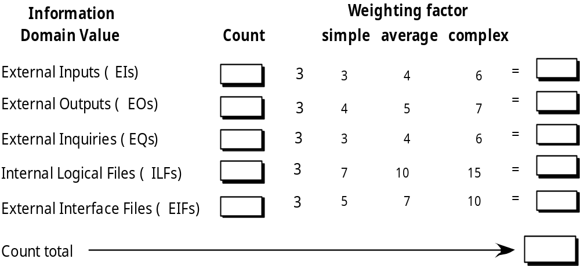
Function Points
Metrics for the Requirements Model

Slide 15
Architectural Design Metrics
Metrics for the
Design Model
Architectural design metrics
  Structural complexity = g(fan-out)
  Data complexity = f(input & output variables, fan-out)
  System complexity = h(structural & data complexity)
HK metric: architectural complexity as a function of fan-in and fan-out
Morphology metrics: a function of the number of modules and the number of interfaces between modules

Slide 16
Metrics for OO Design-I
Metrics for the
Design Model
Whitmire [Whi97] describes nine distinct and measurable characteristics of an OO design:
Size
  Size is defined in terms of four views: population, volume, length, and functionality
Complexity
  How classes of an OO design are interrelated to one another
Coupling
  The physical connections between elements of the OO design
Sufficiency
  “the degree to which an abstraction possesses the features required of it, or the degree to which a design component possesses features in its abstraction, from the point of view of the current application.”

Slide 17
Metrics for OO Design-II
Metrics for the
Design Model
Completeness
  An indirect implication about the degree to which the abstraction or design component can be reused
Cohesion
  The degree to which all operations working together to achieve a single, well-defined purpose
Primitiveness
  Applied to both operations and classes, the degree to which an operation is atomic
Similarity
  The degree to which two or more classes are similar in terms of their structure, function, behavior, or purpose
Volatility
  Measures the likelihood that a change will occur

Slide 18
Class-Oriented Metrics
Metrics for the
Design Model
Proposed by Chidamber and Kemerer [Chi94]:
weighted methods per class
depth of the inheritance tree
number of children
coupling between object classes
response for a class
lack of cohesion in methods

Slide 19
Class-Oriented Metrics
Metrics for the
Design Model
Proposed by Lorenz and Kidd [Lor94]:
class size
number of operations overridden by a subclass
number of operations added by a subclass
specialization index

Slide 20
Class-Oriented Metrics
Metrics for the
Design Model
The MOOD Metrics Suite [Har98b]:
Method inheritance factor
Coupling factor
Polymorphism factor

Slide 21
Operation-Oriented Metrics
Metrics for the
Design Model
Proposed by Lorenz and Kidd [Lor94]:
average operation size
operation complexity
average number of parameters per operation

Slide 22
Component-Level Design Metrics
Metrics for the
Design Model
Cohesion metrics: a function of data objects and the locus of their definition
Coupling metrics: a function of input and output parameters, global variables, and modules called
Complexity metrics: hundreds have been proposed (e.g., cyclomatic complexity)

Slide 23
Interface Design Metrics
Metrics for the
Design Model
Layout appropriateness: a function of layout entities, the geographic position and the “cost” of making transitions among entities

Slide 24
Design Metrics
for Web and Mobile Apps
Does the user interface promote usability?
Are the aesthetics of the WebApp appropriate for the application domain and pleasing to the user?
Is the content designed in a manner that imparts the most information with the least effort?
Is navigation efficient and straightforward?
Has the WebApp architecture been designed to accommodate the special goals and objectives of WebApp users, the structure of content and functionality, and the flow of navigation required to use the system effectively?
Are components designed in a manner that reduces procedural complexity and enhances the correctness, reliability and performance?

Slide 25
Code Metrics
Halstead’s Software Science: a comprehensive collection of metrics all predicated on the number (count and occurrence) of operators and operands within a component or program
  It should be noted that Halstead’s “laws” have generated substantial controversy, and many believe that the underlying theory has flaws. However, experimental verification for selected programming languages has been performed (e.g. [FEL89]).

Slide 26
Metrics for Testing
Testing effort can also be estimated using metrics derived from Halstead measures
Binder [Bin94] suggests a broad array of design metrics that have a direct influence on the “testability” of an OO system.
  Lack of cohesion in methods (LCOM).
  Percent public and protected (PAP).
  Public access to data members (PAD).
  Number of root classes (NOR).
  Fan-in (FIN).
  Number of children (NOC) and depth of the inheritance tree (DIT).

Slide 27
Maintenance Metrics
IEEE Std. 982.1-1988 [IEE94] suggests a software maturity index (SMI) that provides an indication of the stability of a software product (based on changes that occur for each release of the product). The following information is determined:
    M_{T} = the number of modules in the current release
    F_{c} = the number of modules in the current release that have been changed
    F_{a} = the number of modules in the current release that have been added
    F_{d} = the number of modules from the preceding release that were deleted in the current release
The software maturity index is computed in the following manner:
    SMI = [M_{T} - (F_{a} + F_{c} + F_{d})]/M_{T}
As SMI approaches 1.0, the product begins to stabilize.

Slide 28
Metrics in the Process
and Project Domain
A Good Manager Measures
process
process metrics
project metrics
measurement
product metrics
product
What do we
use as a
basis?
• size?
• function?

Slide 29
Process Measurement
Metrics in the Process
and Project Domain
We measure the efficacy of a software process indirectly.
  That is, we derive a set of metrics based on the outcomes that can be derived from the process.
  Outcomes include
    measures of errors uncovered before release of the software
    defects delivered to and reported by end-users
    work products delivered (productivity)
    human effort expended
    calendar time expended
    schedule conformance
    other measures.
We also derive process metrics by measuring the characteristics of specific software engineering tasks.

Slide 30
Software Process Improvement
Metrics in the Process
and Project Domain
Process model
SPI
Process improvement
recommendations
Improvement goals
Process metrics

Slide 31
Process Metrics
Metrics in the Process
and Project Domain
Quality-related
  focus on quality of work products and deliverables
Productivity-related
  Production of work-products related to effort expended
Statistical SQA data
  error categorization & analysis
Defect removal efficiency
  propagation of errors from process activity to activity
Reuse data
  The number of components produced and their degree of reusability

Slide 32
Project Metrics
Metrics in the Process
and Project Domain
used to minimize the development schedule by making the adjustments necessary to avoid delays and mitigate potential problems and risks
used to assess product quality on an ongoing basis and, when necessary, modify the technical approach to improve quality.
every project should measure:
  inputs—measures of the resources (e.g., people, tools) required to do the work.
  outputs—measures of the deliverables or work products created during the software engineering process.
  results—measures that indicate the effectiveness of the deliverables.

Slide 33
Typical Project Metrics
Metrics in the Process
and Project Domain
Effort/time per software engineering task
Errors uncovered per review hour
Scheduled vs. actual milestone dates
Changes (number) and their characteristics
Distribution of effort on software engineering tasks

Slide 34
Typical Size-Oriented Metrics
Software Measurement
errors per KLOC (thousand lines of code)
defects per KLOC
$ per LOC
pages of documentation per KLOC
errors per person-month
errors per review hour
LOC per person-month
$ per page of documentation

Slide 35
Typical Function-Oriented Metrics
Software Measurement
errors per FP (thousand lines of code)
defects per FP
$ per FP
pages of documentation per FP
FP per person-month

Slide 36
Comparing LOC and FP
Software Measurement
Representative values developed by QSM

Slide 37
Why Opt for FP?
Software Measurement
Programming language independent
Used readily countable characteristics that are determined early in the software process
Does not “penalize” inventive (short) implementations that use fewer LOC that other more clumsy versions
Makes it easier to measure the impact of reusable components

Slide 38
Object-Oriented Metrics
Software Measurement
Number of scenario scripts (use-cases)
Number of support classes (required to implement the system but are not immediately related to the problem domain)
Average number of support classes per key class (analysis class)
Number of subsystems (an aggregation of classes that support a function that is visible to the end-user of a system)

Slide 39
WebApp Project Metrics
Software Measurement
Number of static Web pages (the end-user has no control over the content displayed on the page)
Number of dynamic Web pages (end-user actions result in customized content displayed on the page)
Number of internal page links (internal page links are pointers that provide a hyperlink to some other Web page within the WebApp)
Number of persistent data objects
Number of external systems interfaced
Number of static content objects
Number of dynamic content objects
Number of executable functions

Slide 40
Measuring Quality
Metrics for
Software Quality
Correctness — the degree to which a program operates according to specification
Maintainability —the degree to which a program is amenable to change
Integrity —the degree to which a program is impervious to outside attack
Usability —the degree to which a program is easy to use

Slide 41
Defect Removal Efficiency
Metrics for
Software Quality
DRE = E /(E + D)
where:
E is the number of errors found before
delivery of the software to the end-user
D is the number of defects found after delivery.

Slide 42
Exercise
You have been appointed a project manager for a major software products company. Your job is to manage the development of the next-generation -version of its widely used wordprocessing software. Because competition is intense, tight deadlines have been established and announced. What team structure would you choose and why?. What software process model(s) would you choose and why?

Slide 43
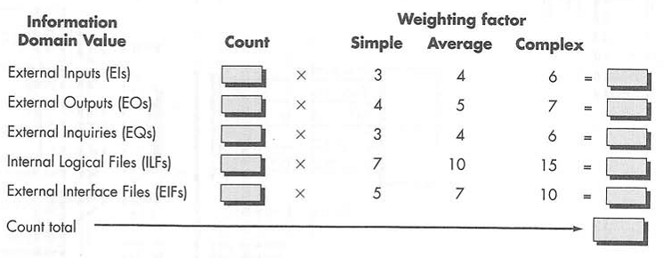
Exercise
Find the Function Point (FP)
Assume that the count of all information domain values are 4 and the weighting factor is Average. And also from, the 14 questions to find value adjustment factors is answered 3 as average. If the project software that have been done with FP 120 needs $ 3000, count the estimate cost for the above project ?

Slide 44
References
Pressman, R.S. (2015). Software Engineering : A Practioner's Approach. 8th ed. McGraw-Hill Companies.Inc, Americas, New York. ISBN : 978 1 259 253157.
Project Management
http://www.pricesystems.com/resources/mf_risks_remedies_facts.asp
Project Portfolio Management
http://www.daptiv.com/index.htm
SW Metrics
http://www.spc.ca/resources/metrics/
Function Point Measurement
http://www.functionpoints.com
SW Metrics service Estimation http://www.charismatek.com/_public4/html/services/pdf/service_estimate.pdf

Slide 45
Q & A

